Slide 1
21CSE221T - Big Data Tools and Techniques
Unit I – Introduction to Big Data and Hadoop

Slide 2
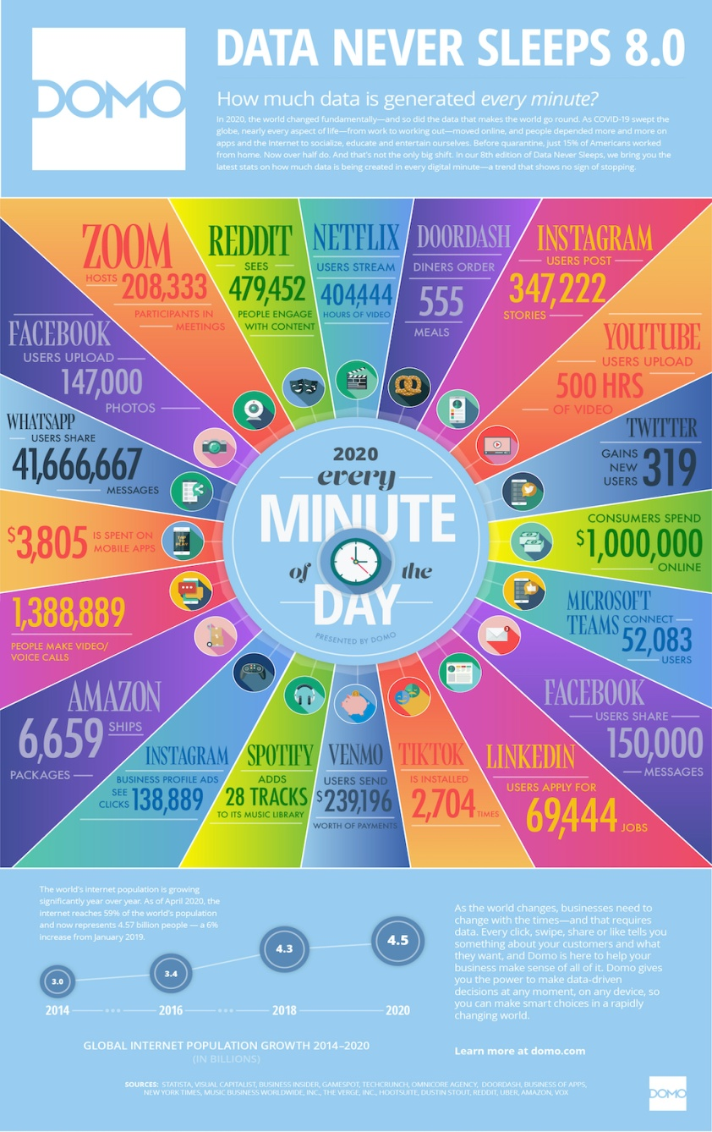
Big Data
Infographic courtesy: DOM Inc, 2020

Slide 3
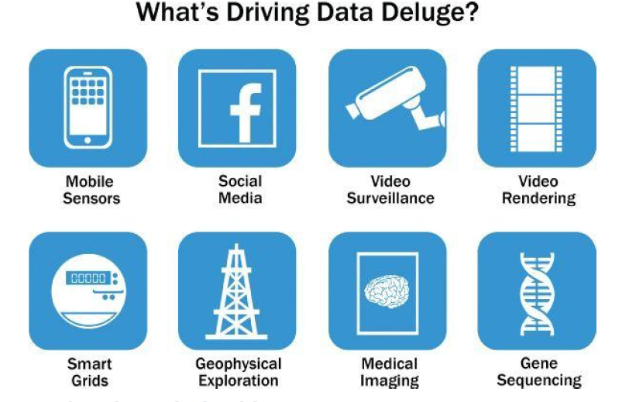
Sources of Big Data

Slide 4
Big Data Analytics
Performing operations like data mining, machine learning or deep learning to large scale datasets.
Operations can be as simple as counting or as complicated as large scale complex neural network analysis.

Slide 5
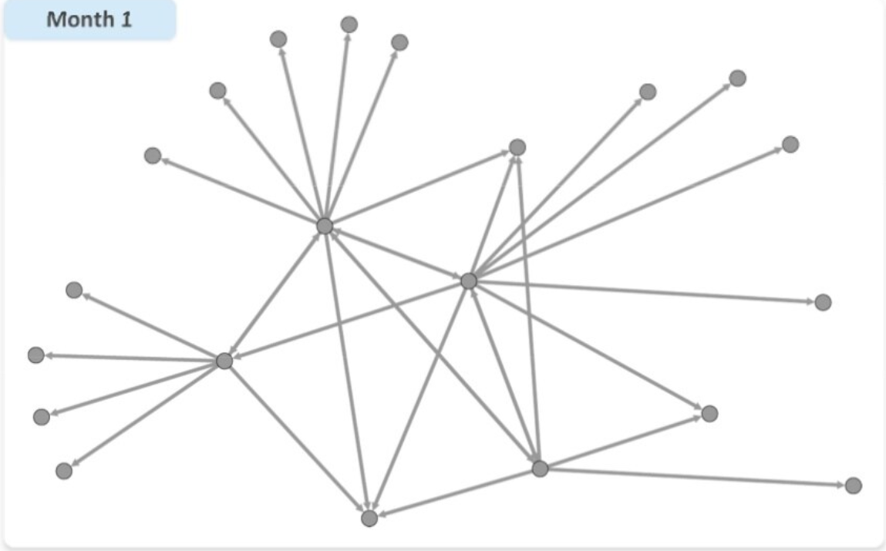
Example – Mobile SP Churn Prediction
Courtesy: EMC

Slide 6
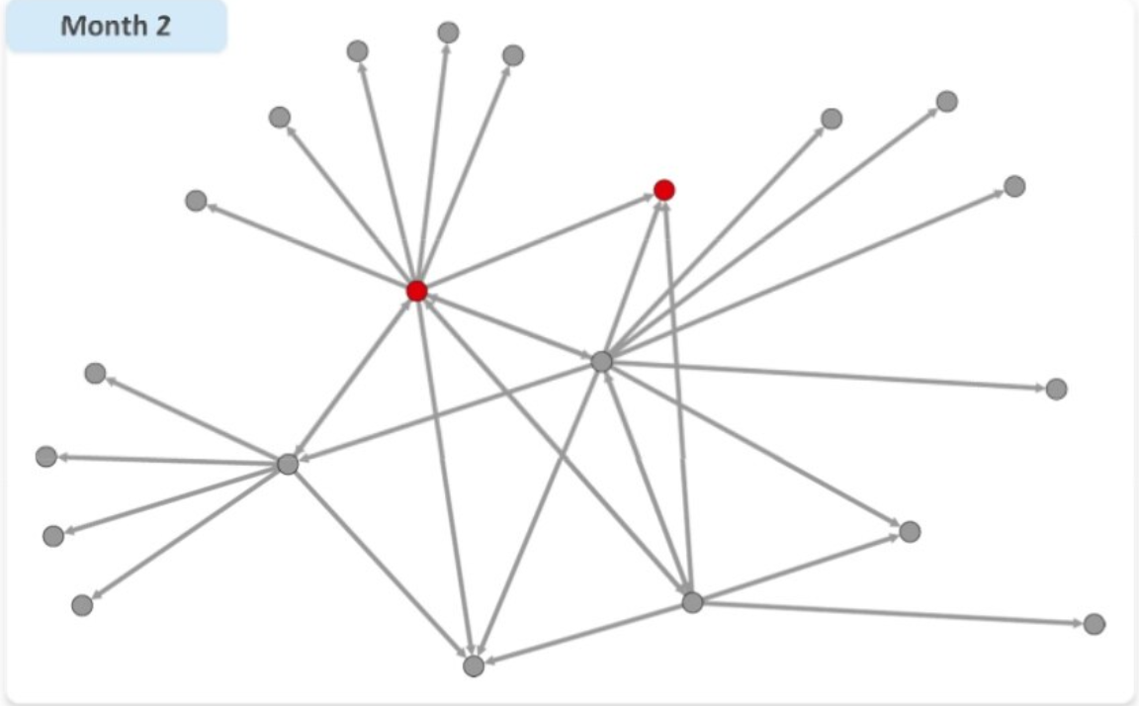
Example – Mobile SP Churn Prediction
Courtesy: EMC

Slide 7
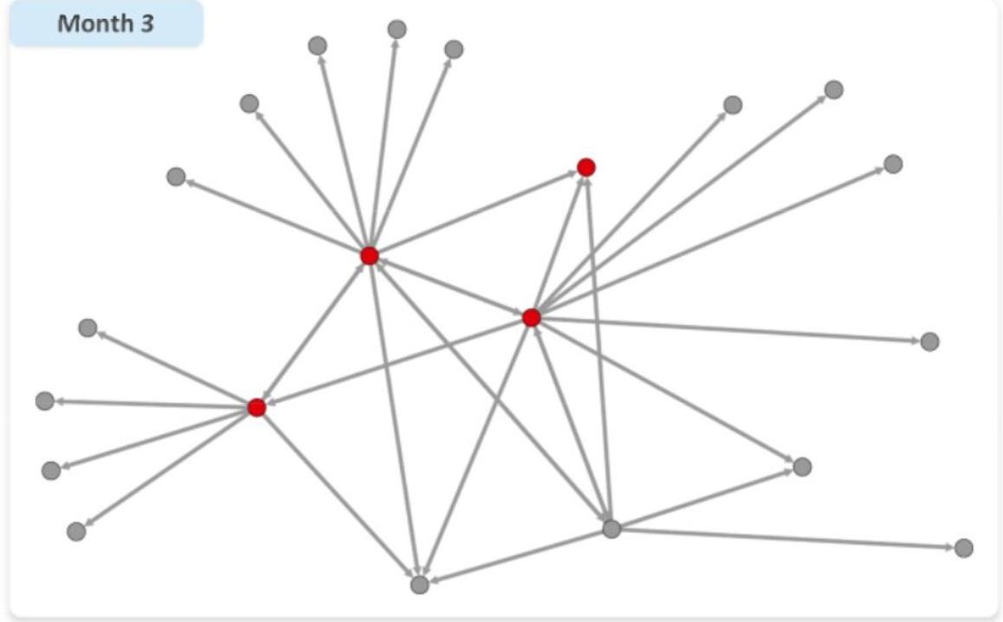
Example – Mobile SP Churn Prediction
Courtesy: EMC

Slide 8
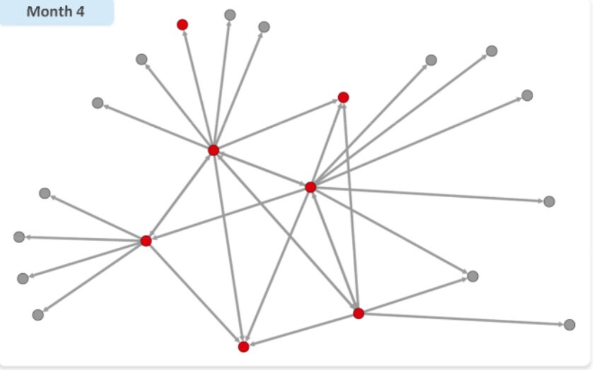
Example – Mobile SP Churn Prediction
Courtesy: EMC

Slide 9
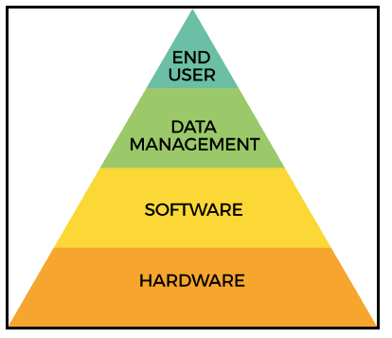
Building Blocks of Big Data Analytics

Slide 10
Characteristics of Big Data
Volume
Variety
Velocity
Veracity

Slide 11
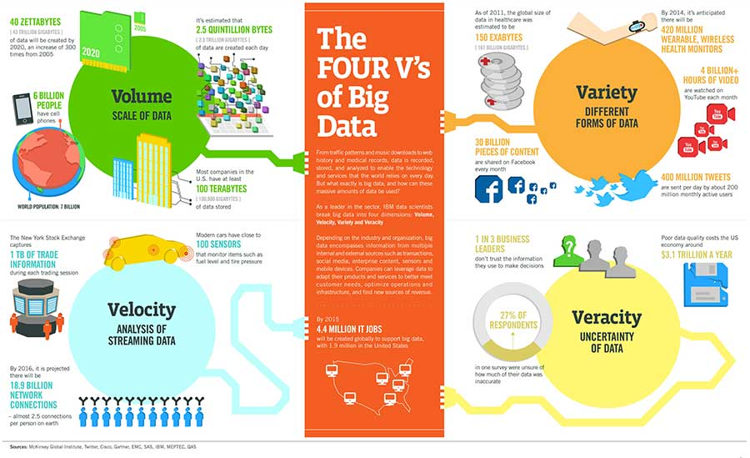
Characteristics of Big Data
Courtesy: IBM

Slide 12
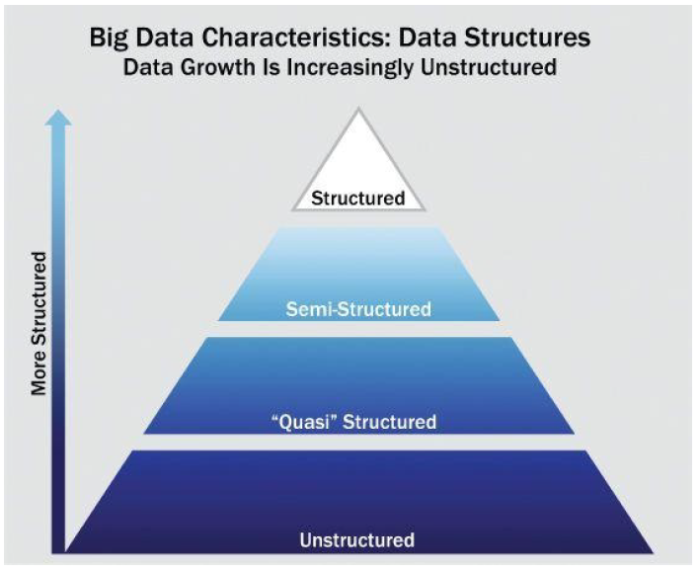
Types of data
Courtesy: EMC

Slide 13
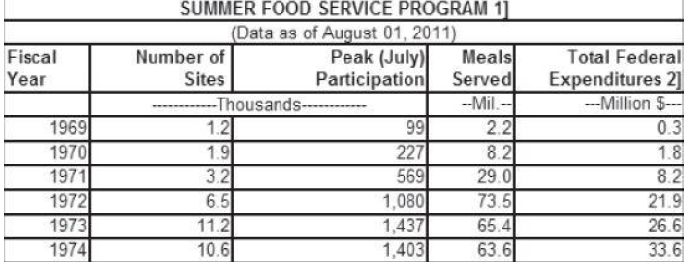
Structured data
Data having defined organizational structure
Uses a representable schema
All possible data types
Store and query

Slide 14
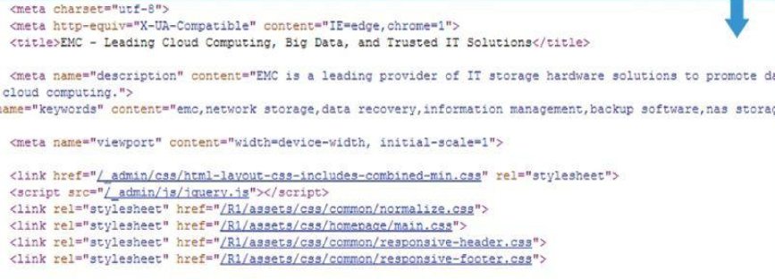
Semi-structured data
Textual data type with a discernible pattern
XML, JSON
XML or JSON schema
MongoDB, Couch DB for storage

Slide 15
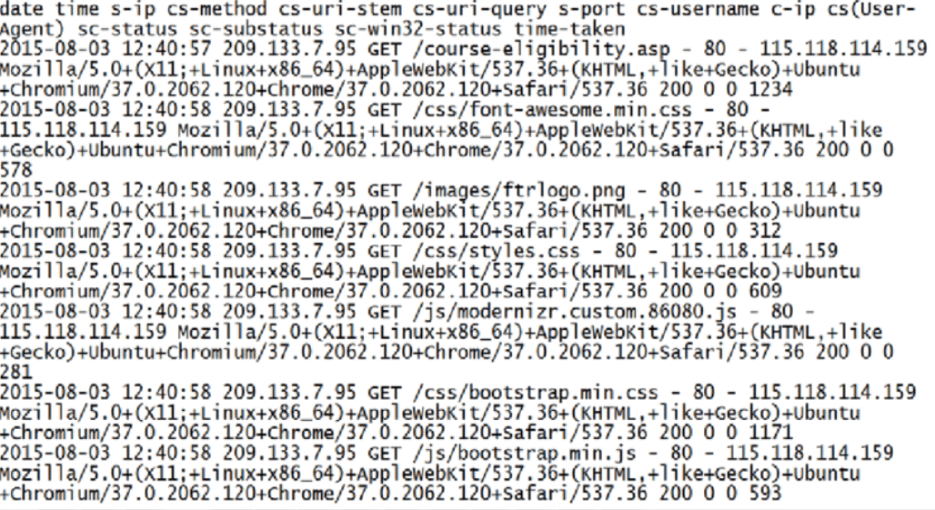
Quasi structured data
Textual data but with inconsistencies
Effort and time to pre process
E.g Clickstream data, Web server log, Network packet tracing

Slide 16
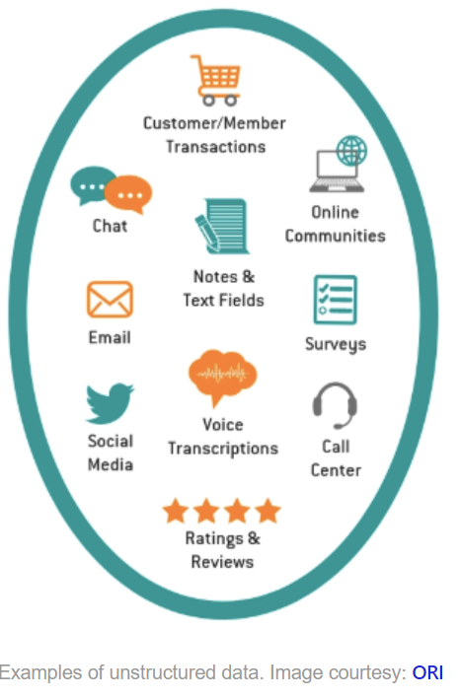
Unstructured data
Data that has no inherent structure
Videos, Images, Documents
Text data
ElastiSearch, Solr

Slide 17
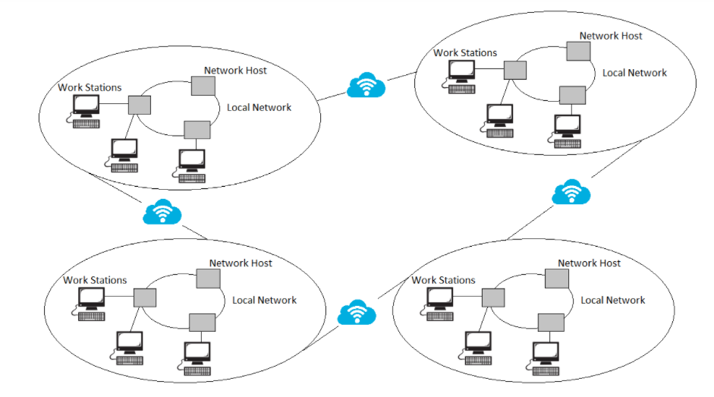
Distributed Computing for Big Data
Usage of more than one connected computer
Examples: NoW(Network of Workstations)

Slide 18
Distributed Computing for Big Data
Treated infrastructure as one big pool of computing, storage and networking resources
Moves to another resource in the pool in case of failure
Fault Tolerance or High Availability
Cost of computing and storage resources has decreased considerably
E.g Distributed File System

Slide 19
Parallel Computing for Big Data
Serial – Sequence of instructions one by one
Start to Finish on a single processor
Parallel Programming
Processing broken into multiple parts
Each part executed concurrently
Different CPUs on a single or different machines

Slide 20
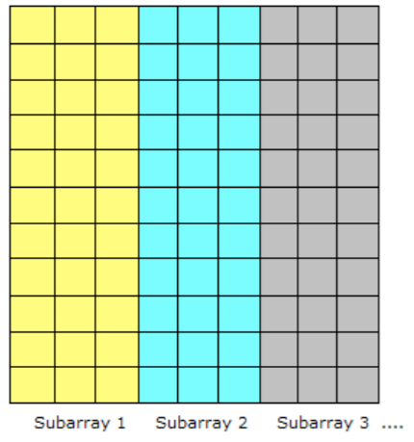
Parallel Computing for Big Data
First step
Identify set of tasks that could be run concurrently
Data partitioned without dependencies

Slide 21
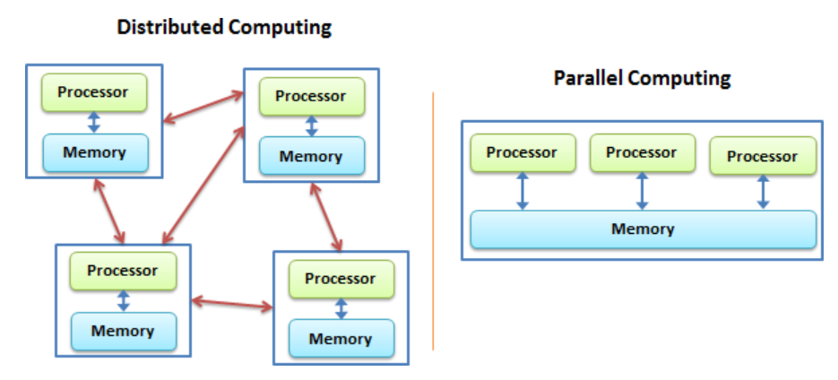
Distributed, Parallel Computing

Slide 22
Cloud Computing for big data
Set of high powered servers
Pay as you use
Memory or Storage intensive
View and query large data sets quickly
Infrastructure as a Service
Platform as a Service
Software as a Service

Slide 23
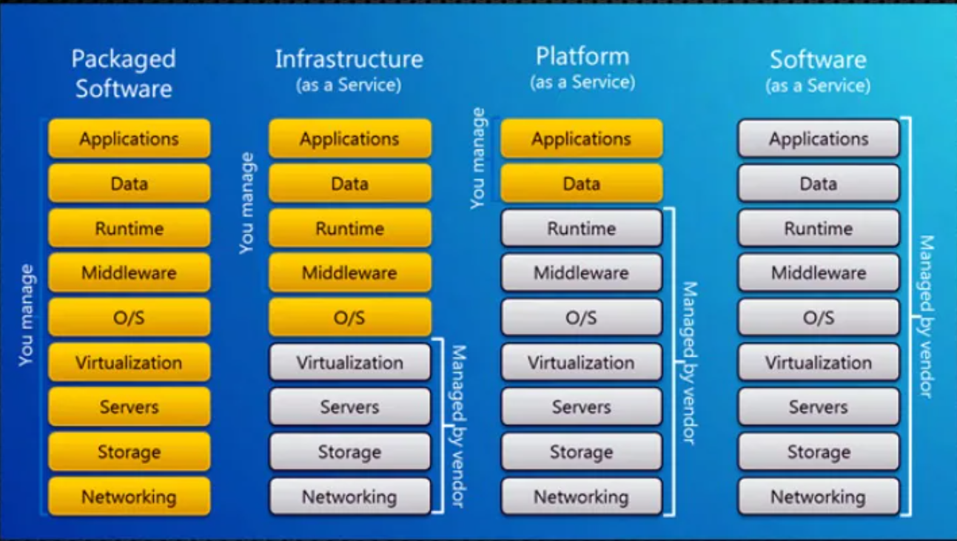
Cloud Computing for big data

Slide 24
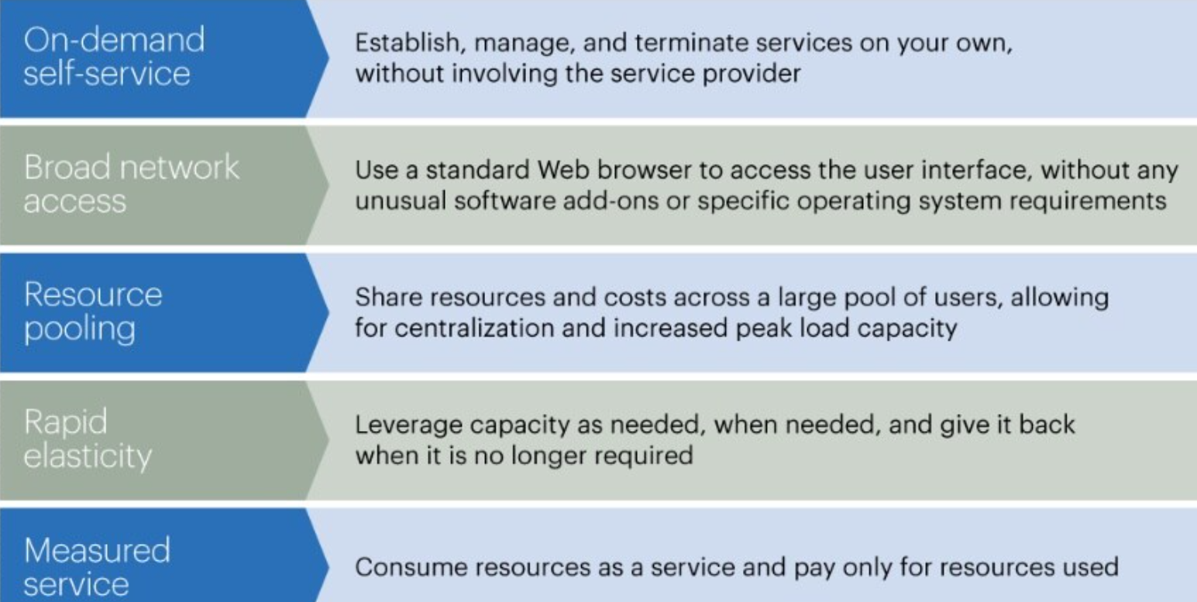
Drivers of Cloud Computing for big data

Slide 25
Cloud Computing for big data
Need not ship terabytes of data around
Store in cloud and move analytics close to data
Store insensitive data in cloud
Sensitive data – Private Cloud/Clusters
Advantages
Scalability
Cost reduction
Faster time to market

Slide 26
Cloud Computing for big data
Limitations
Latency
Multi-tenancy overhead
Data privacy
Data Security
Costs are charged for static storage

Slide 27
In-memory computing for big data
Computations are latency sensitive
Have to be done in memory
Disk reads and writes would cause delays
For compute-intensive applications
Real time stream processing
Apache Spark

Slide 28
Big Data Mining
Two broad categories of BDA
Big Data Mining
Predictive Analytics
Big Data Mining
Refers to the entire life cycle of processing large data sets
From procurement of data to implementation of respective tools to analyze data

Slide 29
Big Data Mining – Building Corporate Big Data strategy
Determine use cases
Then fix the platforms
Steps
Who needs big data mining?
Which business groups will benefit significantly?
Revenue impact
E.g Pharmaceutical company – Commercial Research, Epidemiology, Health Economics

Slide 30
Big Data Mining – Building Corporate Big Data strategy
Determining use cases
Impactful analysis by working closer with practitioner (analyst) and stakeholder (business end user)
Analyst will work on operational challenges that might be faced in implementing the BD solution
Business user will highlight the aspects of business that will benefit from the BD solution
An optimal outcome consolidating both

Slide 31
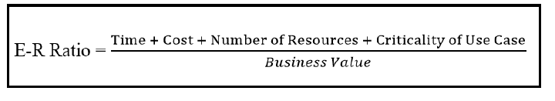
Big Data Mining – Building Corporate Big Data strategy
Stakeholder’s buy in
Budget decisions
Establish a baseline
Can be leveraged on successful BD solution implementation
Early wins and effort-to-reward ratio
Relatively small use case
Implemented in short time, smaller budget
Optimizes a business critical function
Early win

Slide 32
Big Data Mining – Building Corporate Big Data strategy
Leveraging the early wins
Ground to develop bigger strategy
Establishing value of big data to an audience
Single department to broader organizational impact

Slide 33
Big Data Mining - Stakeholders
Business Sponsor
Funding department for the project
Benefits from the solution
Implementation group
Analysts, Data Scientist, Field workers
IT procurement
Licensing cost
Software, Cloud Renting
Legal
Licensing
Open source or in-house

Slide 34
Technical elements of BD platform
Selection of hardware stack
Selection of software stack

Slide 35
Selection of hardware stack
Proper choice depends on key metrics
Type of data
Size of data
Frequency of data updates
Three broad models of hardware architecture
Multi-node architecture
Single node architecture
Cloud based architecture

Slide 36
Selection of hardware stack
Multi-node architecture
Multiple nodes or servers connected
Distributed computing
Commodity Servers (low end machines that work in tandem to provide large scale mining and analytics capabilities)
Data range TBs and above

Slide 37
Selection of hardware stack
Single node architecture
Single server
Structured text data
1-5TB
Not commonly used
Restricted environments (mobile)

Slide 38
Selection of hardware stack
Cloud architecture
Most efficient
Reduced costs in procuring, maintaining physical hardware and hosting software
Elastic, provisions on demand
Amazon AWS, Microsoft Azure, Google Compute
IBM Cloud Brokerage – Selct and manage multiple cloud based solutions

Slide 39
Selection of software stack
Popular options
Hadoop Ecosystem
Multiple projects under Apache Software Foundation
Hadoop Common
Hadoop Mapreduce
Hadoop Distributed File System
Hadoop YARN
Apache Spark
UC Berkeley AMPLab
Overcomes limitations of Hadoop
Supports many languages, Python and Scala API
Resilient Distributed Dataset (RDDs)
Integration with existing Cluster managers like Mesos, YARN
Distributed Storage

Slide 40
Selection of software stack
Popular options
NoSQL Storage
Key Value (Redis, Riak)
In-memory (Redis, KDB+)
Columnar (Cassandra, Google BigTable)
Document-based (MongoDB)
Cloud based solutions
SaaS, AaaS
Data ware houses or storage in Cloud
Routine tasks like backup are taken care by the vendor

Slide 41
Try answering!
Which of the below is an example for quasi structured data?
Employee information in spreadsheets
Images
Audio fles
Clickstream data

Slide 42
Try answering!
Breaking the process into multiple parts and executing each part concurrently is ----------- paradigm
Distributed Computing
Parallel Processing
Cloud Computing
In-memory computing

Slide 43
Try answering!
Which of the below statements is related to the attribute “veracity” of big data
420 million wearable wireless health monitoring sensors
2.5 quintillion bytes of data generated everyday
Poor data quality costs aroung $1 trillion very year to US

Slide 44
Try answering!
Which of the below is not a Big Data Processing Engine/Framework
Hadoop
Spark
YARN
Flink

Slide 45
Try answering!
Which of the below is a NoSQL Storage platform that stores as documents
Redis
MongoDB
Cassandra
IBM DB2

Slide 46
History of Hadoop
Inspired by GFS paper in 2003
Doug Cutting was part of Nutch and Lucene
NDFS – Nutch Distributed File System
Was moved as a separate project Hadoop

Slide 47
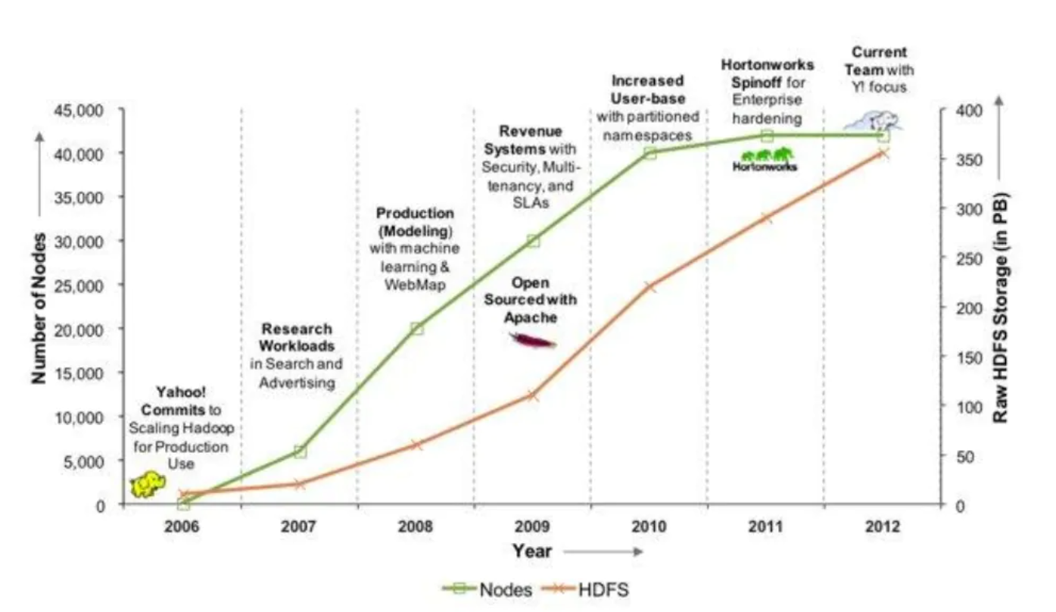
Hadoop @ Yahoo

Slide 48
Why Hadoop
Failure of nodes
Scalability of nodes
Petabytes of data to be processed in parallel
Cost effective
Efficient
Data Locality
Minimal impact to program logic

Slide 49
Apache Hadoop
Open source framework
Distributed storage and processing
Of large scale data sets
On commodity hardware
Quickly gain insights from structured and unstructured data

Slide 50
Apache Hadoop - Core components
Hadoop Common
Has libraries and utilities required by other modules
Hadoop Distributed File System (HDFS)
Distributed FS
Stores data on commodity machines
Very high aggregate bandwidth across clusters

Slide 51
Apache Hadoop - Core components
Hadoop Mapreduce
A programming model for large scale data processing
Hadoop YARN
Resource management platform
Manages computing resources in clusters
Schedules user applications on computing resources

Slide 52
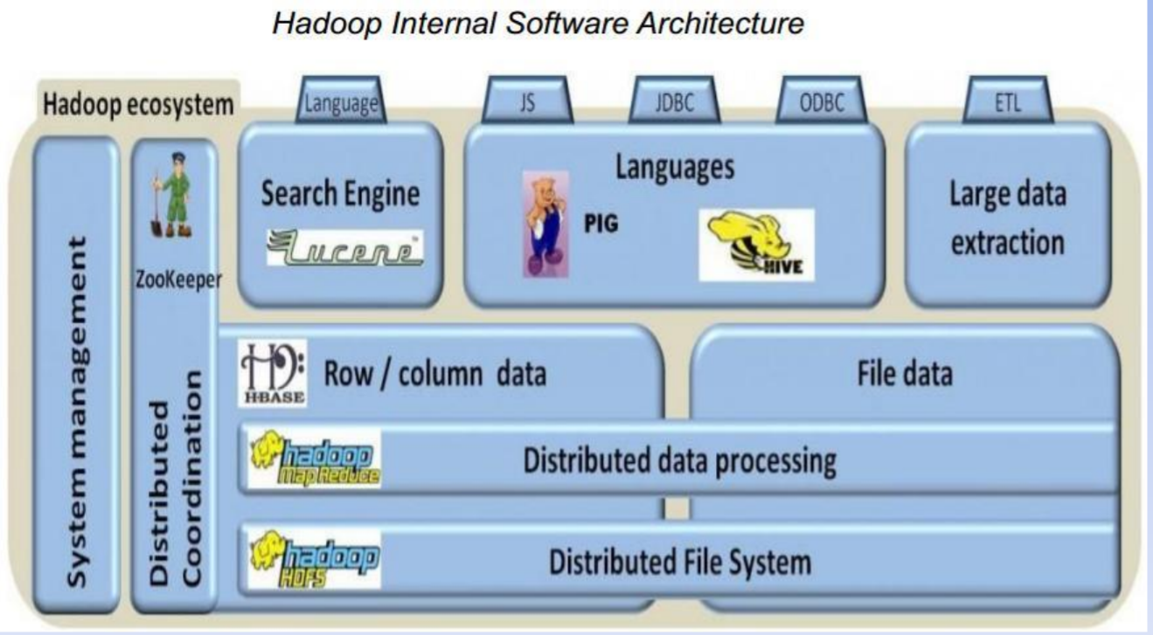
Hadoop Core Components

Slide 53
Hadoop Core Components Summary
Four major components
Storage --> HDFS
Processing --> MR
Scheduling --> YARN
Common utilities
Mostly written in Java

Slide 54
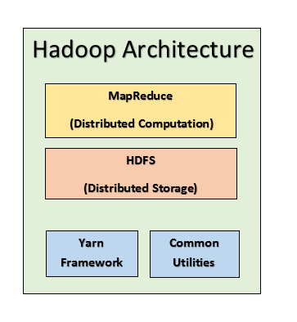
Hadoop Core Components

Slide 55
File System
Methods and data structures that an OS uses to keep track of files on a disk or partition
Allocates space
Responsible for organizing files and directories
Unused space/Slack Space – Allocation size

Slide 56
Distributed File System
File systems that manage storage across a n/w of machines
Network based - so more complex than regular file systems
Example: Tolerate node failure without data loss.
Distribution is hidden and is not visible to the user
High throughput data access

Slide 57
HDFS
How HDFS is different?
Highly fault tolerant
Designed for low cost hardware
High throughput access to data
Suitable For | Not Suitable For
Very large files | Low-latency data (Hbase is a better choice)
Streaming data access | Lots of small files
Commodity hardware | Multiple writes, arbitrary access

Slide 58
HDFS
Follows a master slave architecture
HDFS Cluster (Group of connected machines)
Name node
Secondary Name node
Multiple Data nodes

Slide 59
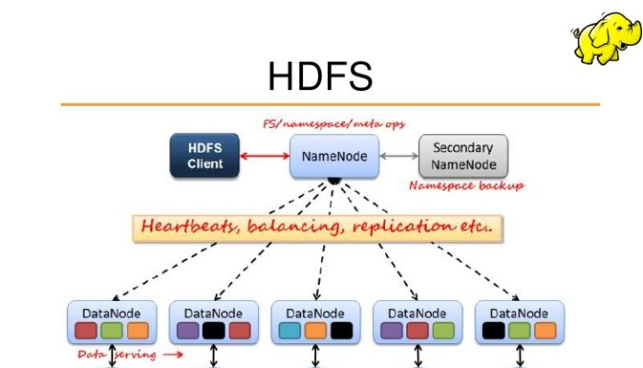

Slide 60
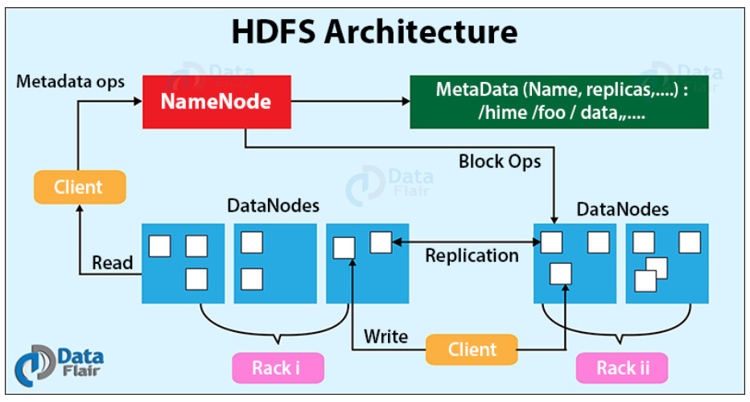
HDFS Architecture

Slide 61
HDFS Concepts
Blocks
Namenodes
DataNodes
Block Caching
HDFS Federation
HDFS High Availability

Slide 62
HDFS Blocks
Disk Block – 512 bytes
File System Block – few kBs
HDFS Block size – 128 MB
Files in HDFS are broken into block size chunks
Advantages of block abstraction
One file can be larger than a hard disk
Blocks from a single file can be stored across multiple disks
Simplicity
Fit with replication

Slide 63
Name Node
Master node
Maps file to blocks and blocks to nodes
Maintains file system tree and metadata for all files
Two files
FSImage
Edit log
Maintains status of data node
Heartbeats
Blockreport
Manages replication
Block corruption
Data node failure
Disk failure

Slide 64
Name Node
Data Integrity
Checksum for each block
Balancing
Addition of new nodes
Decommisioning
Deletion of failed nodes
Maintain metadata

Slide 65
Name Node
Without name node, HDFS cannot be used
FS does not know to construct a file
Should be resilient to failure
Metadata is persisted with back up
Secondary name node

Slide 66
Secondary Name node
Present on a separate physical machine
Does not act as a name node
Periodically merges edit log with namespace image.
Keeps a copy of the merged namespace image and edit log
Data loss is certain

Slide 67
Block Caching
Data nodes read blocks from disk
Frequently accessed files – blocks are cached in memory
Off-heap block cache
Job schedulers run tasks on data node where data is cached for better performance
Users or application can configure what to cache and how long

Slide 68
HDFS Federation
Single namenode
Keeps track of every file and block
Very large clusters with many files?
Memory becomes a limiting factor for scaling
Multiple name nodes
Each will manage a portion of file system
Each namenode manages a name space volume
Namespace (Dedicated for each NN – no overlap)
Block pool (DNs register with each NN and store blocks from multiple block pools)
Name nodes are independent and failure of one does not affect other

Slide 69
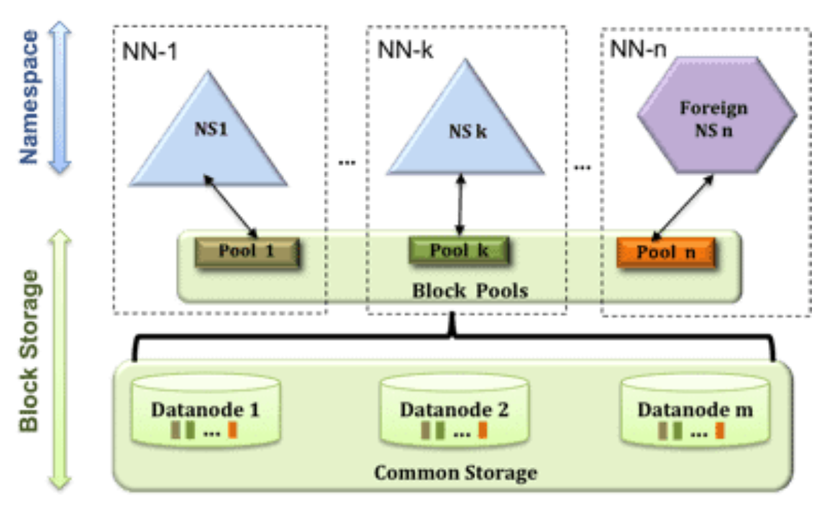
HDFS Federation
Courtesy: Cloudera

Slide 70
High Availability
Secondary NN or Backup
SPOF
Recovery from a failure
Admin starts a new NN with FS replicas
Asks the DNs to use the new NN
New NN is not ready till
loaded its namespace image into memory
replayed its edit log, and
received enough block reports from the datanodes to leave safe mode.

Slide 71
High Availability
Takes 30 mins for large clusters
From Hadoop 2 - pair of namenodes in an active-standby configuration
Architectural changes required:
The namenodes must use highly available shared storage to share the edit log.
Datanodes must send block reports to both namenodes
Clients must be configured to handle namenode failover
Includes Secondary NN functionality

Slide 72
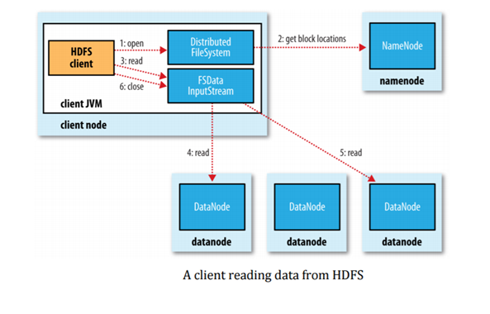
Anatomy of a file read

Slide 73
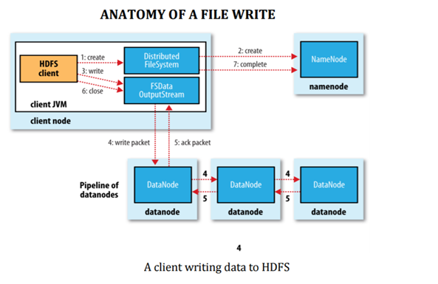
Anatomy of a file write

Slide 74
Basic HDFS Shell Commands
https://hadoop.apache.org/docs/r1.2.1/file_system_shell.html

Slide 75
Map Reduce

Slide 76
Map Reduce
A programming model for data processing
Hadoop can run MapReduce programs written in various languages
MapReduce programs are inherently parallel
No special hardware required
Based on divide-and-conquer principle

Slide 77
Map Reduce
Input data sets are split into independent chunks, which are processed by the mappers in parallel
Execution of the maps is typically co-located with the data
MR sorts the outputs of the maps, and uses them as an input to the reducers
Responsibility of the user is to implement mappers and reducers
classes that extend Hadoop-provided base classes to solve a specific problem

Slide 78
Map Reduce
MapReduce works by breaking the processing into two phases
Map phase
Reduce phase
Each phase has key-value pairs as input and output
the types of which may be chosen by the programmer
The programmer also specifies two functions
the map function and the reduce function

Slide 79
Map Reduce
Splits
Input is divided into fixed size chunks
Hadoop creates one map task for each split
Map function is executed for each record of split
Small splits
Less processing time for each split
Parallel – Better load balancing
Too small
Managing is difficult
Good split should be size of HDFS block

Slide 80
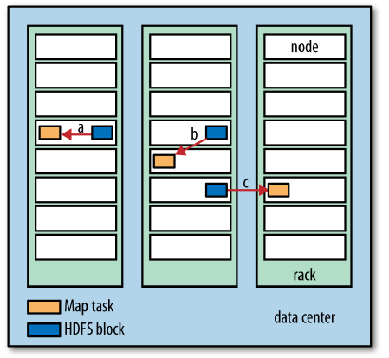
Map Reduce

Slide 81
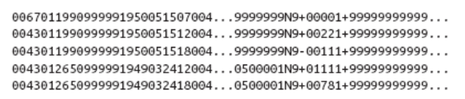
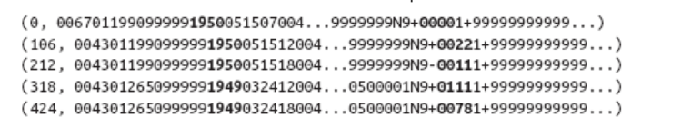
Inputs and Outputs of Map Reduce

Slide 82
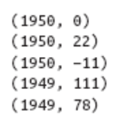
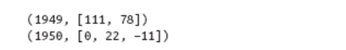
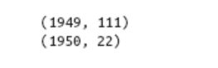
Inputs and Outputs of Map Reduce

Slide 83
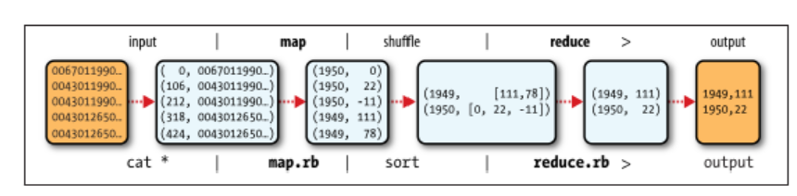
Map Reduce logical data flow

Slide 84
Map Reduce
Mapper - Takes input in a form of key/value pairs (k1, v1) and transforms them into another key/value pair (k2, v2).
The MapReduce framework sorts a mapper’s output key/value pairs and combines each unique key with all its values (k2, {v2, v2,…}).
These key/ value combinations are delivered to reducers, which translate them into yet another key/value pair (k3, v3).

Slide 85
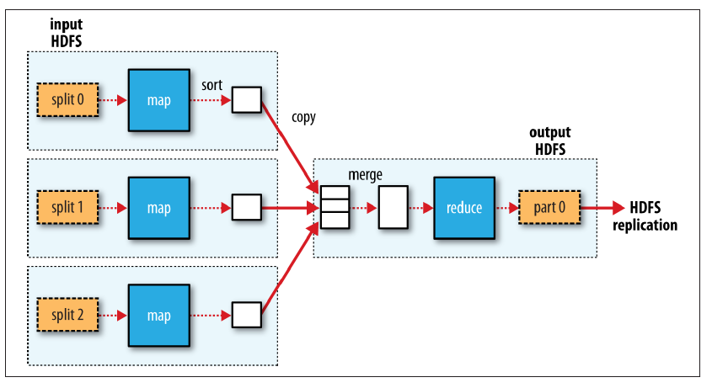
Map Reduce – Single Reduce

Slide 86
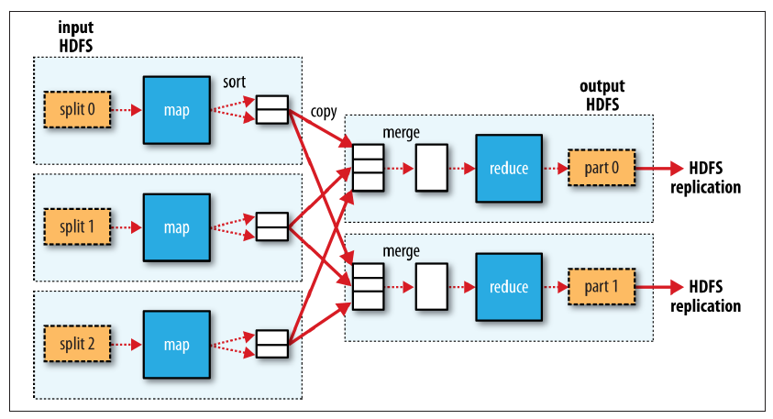
Map Reduce – Multiple reduce

Slide 87
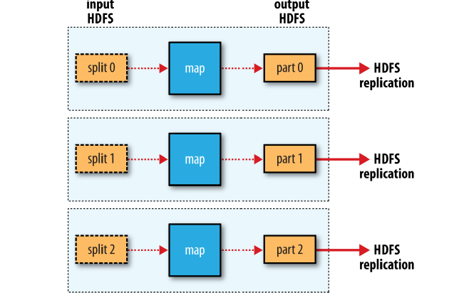
Map Reduce – Zero Reduce

Slide 88
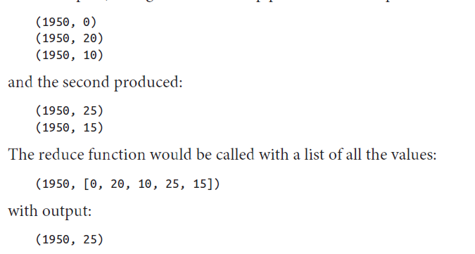

Combiners

Slide 89
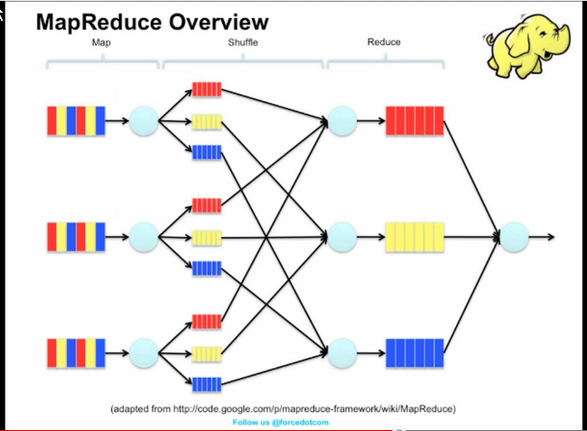
More examples

Slide 90
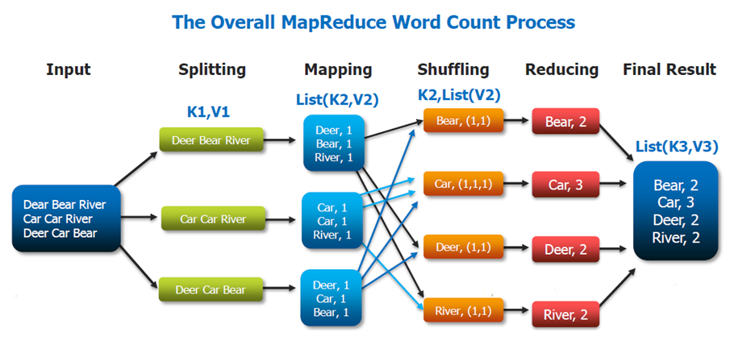
More examples

Slide 91
Hadoop Streaming
A utility that comes with the Hadoop distribution
Mapper and Reducer will be scripts or programs in any language
For example, if we have mapper.py and reducer.py, then the execution is summarized as,
$ $HADOOP_HOME/bin/hadoop jar contrib/streaming/hadoop-streaming-1. 2.1.jar \ -input input_dirs \ -output output_dir \ -mapper <path/mapper.py \ -reducer <path/reducer.py

Slide 92
Hadoop Streaming
A utility that comes with the Hadoop distribution
Mapper and Reducer will be scripts or programs in any language
For example, if we have mapper.py and reducer.py, then the execution is summarized as,
$ $HADOOP_HOME/bin/hadoop jar contrib/streaming/hadoop-streaming-1. 2.1.jar \ -input input_dirs \ -output output_dir \ -mapper <path/mapper.py \ -reducer <path/reducer.py

Slide 93
Hadoop Ecosystem
Hadoop Ecosystem is a platform or a suite which provides various services to solve the big data problems.
It includes Apache projects and various commercial tools and solutions.
All these tools work collectively to provide services such as absorption, analysis, storage and maintenance of data etc.

Slide 94
Hadoop Ecosystem
HDFS: Hadoop Distributed File System
YARN: Yet Another Resource Negotiator
MapReduce: Programming based Data Processing
Spark: In-Memory data processing
PIG, HIVE: Query based processing of data services
HBase: NoSQL Database
Mahout, Spark MLLib: Machine Learning algorithm libraries
Solar, Lucene: Searching and Indexing
Zookeeper: Managing cluster
Oozie: Job Scheduling

Slide 95
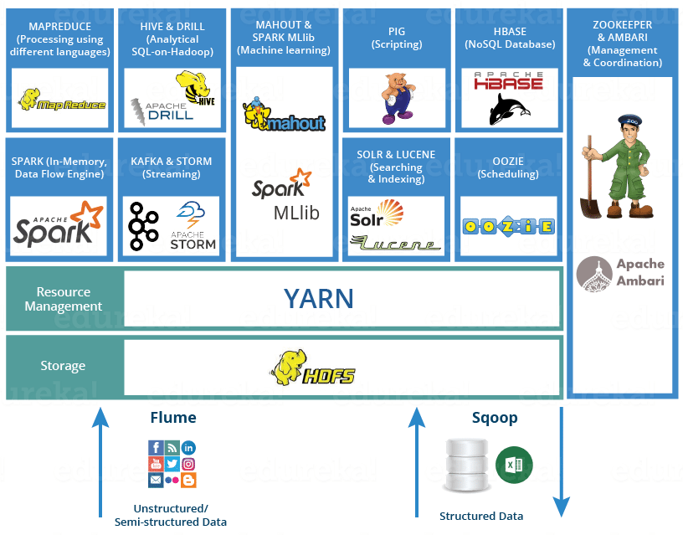
Hadoop Ecosystem
Courtesy: Cloudera

